Slide 1

Geometry
Unit 8, Lesson 6 Solving Real-World Problems with Quadrilaterals Volume 2, pg. 39

Slide 2


Benchmarks
MA.912.GR.1.4
Prove relationships and theorems about parallelograms. Solve mathematical and real-world problems involving postulates, relationships, and theorems of parallelograms.
MA.912.GR.1.5
Prove relationships and theorems about trapezoids. Solve mathematical and real-world problems involving postulates, relationships, and theorems of trapezoids.
volume 2, pg. 39

Slide 3
Integrated Mathematical Thinking and Reasoning Standards
MA.K12.MTR.1.1 Actively participate in effortful learning both individually and collectively.
MA.K12.MTR.4.1 Engage in discussions that reflect on the mathematical thinking of self and others.
MA.K12.MTR.5.1 Use patterns and structure to help understand and connect mathematical concepts.
MA.K12.MTR.6.1 Assess the reasonableness of solutions.
MA.K12.MTR.7.1 Apply mathematics to real-world contexts.
volume 2, pg. 39

Slide 4

Learning Targets
I can use properties of parallelograms to solve real-world problems.
I can use properties of trapezoids to solve real-world problems.
volume 2, pg. 39

Slide 5

Warm-Up
volume 2, pg. 39

Slide 6
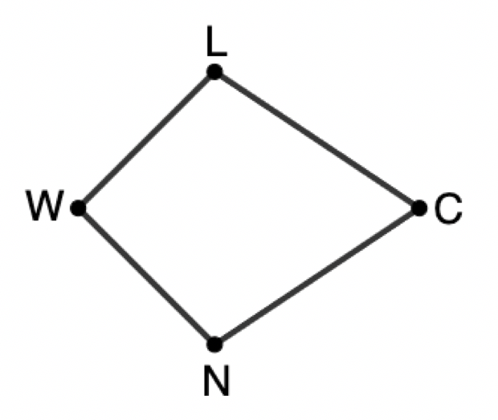
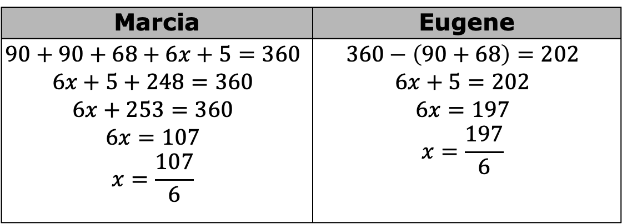
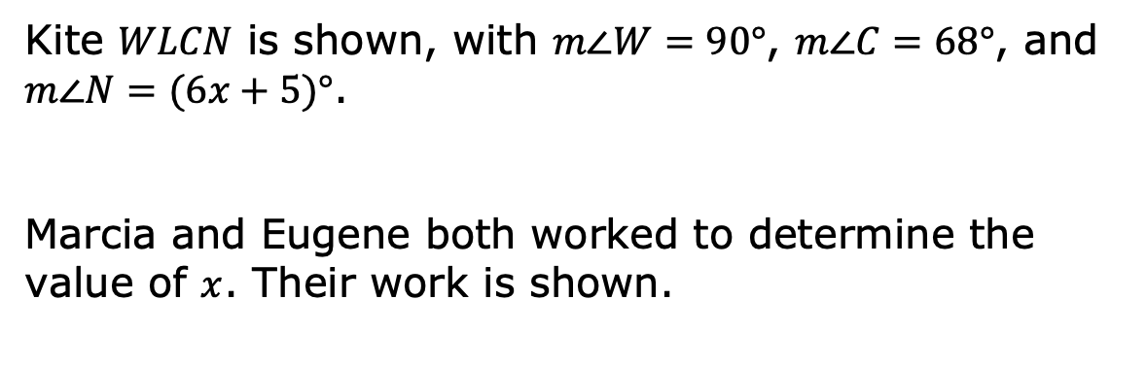
8.6.1 Warm-Up: Error Analysis
Kite $WLCN$ is shown, with $m∠W=90°$, $m∠C=68°$, and
$m∠N=(6x+5)°$.
Marcia and Eugene both worked to determine the value of $x$. Their work is shown.
Marcia | Eugene
$$90+90+68+6x+5=360$$ $$6x+5+248=360$$ $$6x+253=360$$ $$6x=107$$ $$x=\frac{107}{6}$$ | $$360−\left(90+68\right)=202$$ $$6x+5=202$$ $$6x=197$$ $$x=\frac{197}{6}$$
volume 2, pg. 39

Slide 7
Evaluate each student’s work, then write a note to each student explaining the error they made.
Marcia | Eugene
volume 2, pg. 39

Slide 8

Activity
volume 2, pg. 40

Slide 9

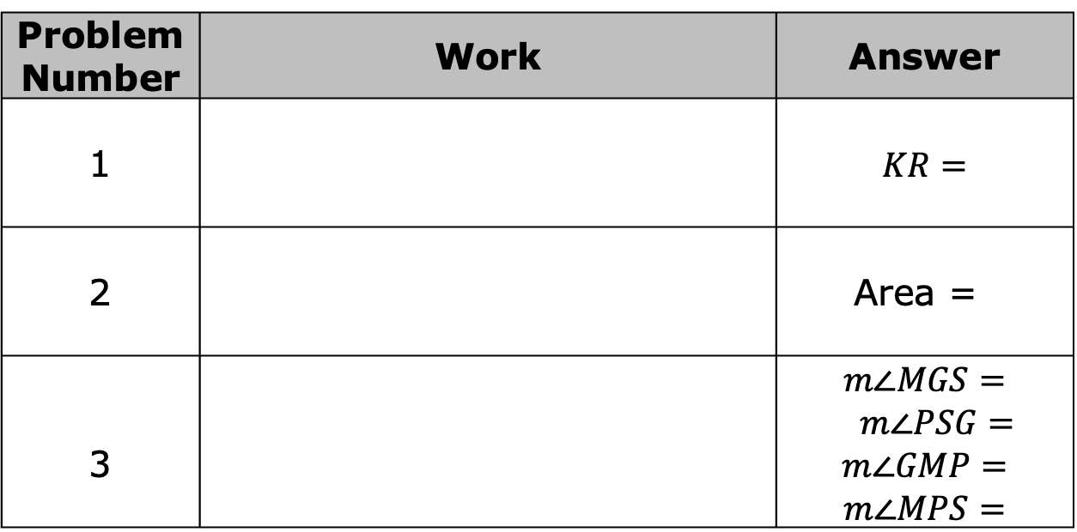
8.6.2 Activity: Word Problem Gallery Walk
Work through the word problems with your partner. Show your work and write your answers in the appropriate boxes below.
Problem Number | Work | Answer
1 |  | $$KR=$$
2 |  | Area =
3 |  | $$m∠MGS=$$ $m∠PSG=$ $$m∠GMP=$$ $$m∠MPS=$$
volume 2, pg. 40

Slide 10
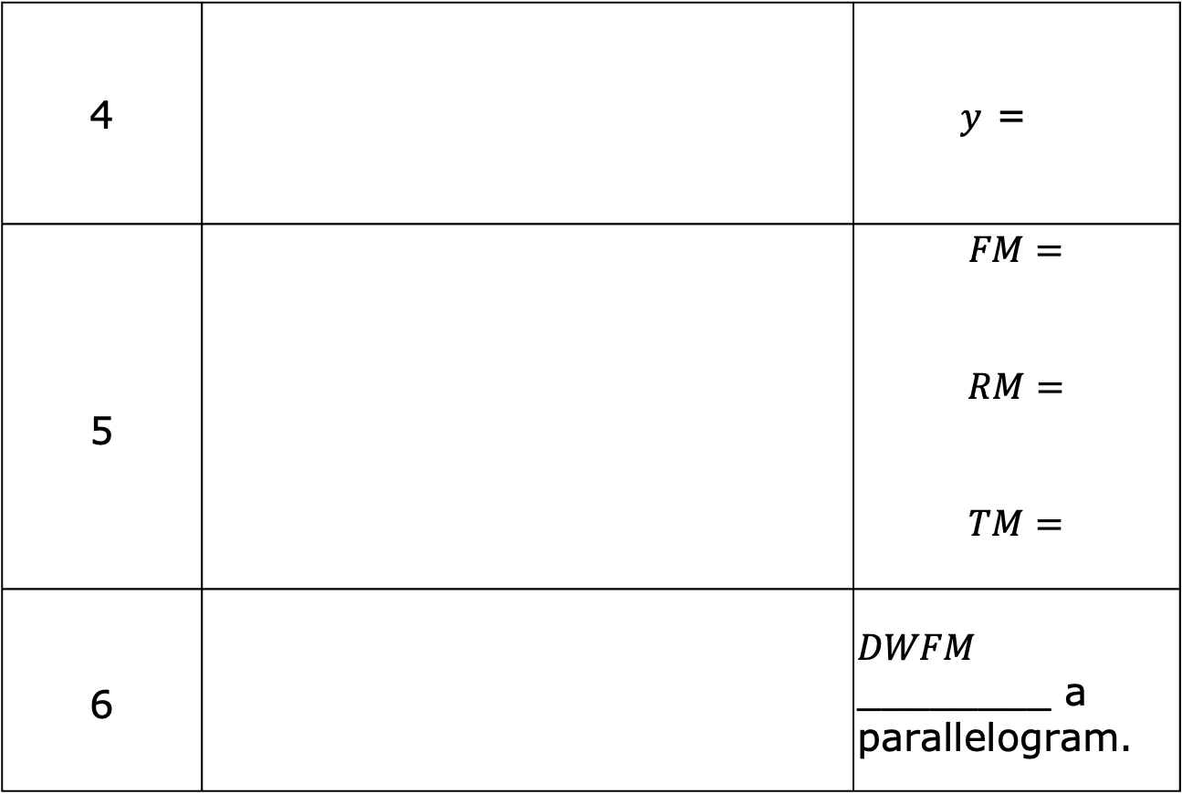
4 |  | $y$ =
5 |  | $$FM=$$ $$RM=$$ $$TM=$$
6 |  | $DWFM$ ________ a parallelogram.
volume 2, pg. 40

Slide 11
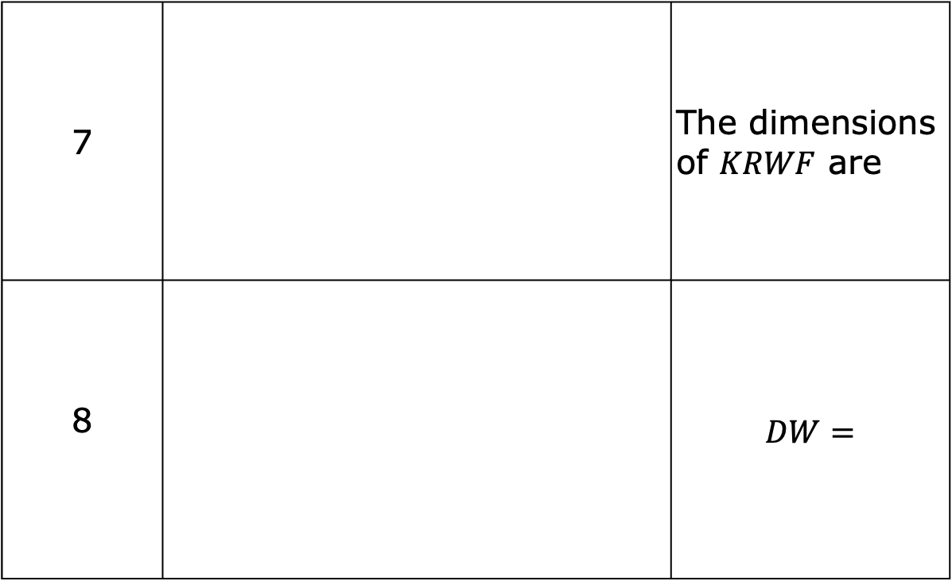
7 |  | The dimensions of $KRWF$ are
8 |  | $$DW=$$
volume 2, pg. 41

Slide 12

Your Turn
volume 2, pg. 41

Slide 13
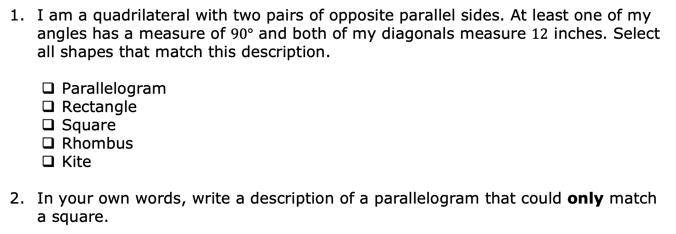
8.6.3 Your Turn!
I am a quadrilateral with two pairs of opposite parallel sides. At least one of my angles has a measure of $90°$ and both of my diagonals measure $12$ inches. Select all shapes that match this description.
Parallelogram
Rectangle
Square
Rhombus
Kite
In your own words, write a description of a parallelogram that could only match a square.
volume 2, pg. 41

Slide 14
If a quadrilateral is a parallelogram, what additional information would be needed to show that the shape is a rectangle?
If a quadrilateral is a parallelogram, what additional information would be needed to show that the shape is a rhombus?
volume 2, pg. 41

Slide 15

Wrap-Up
volume 2, pg. 42

Slide 16
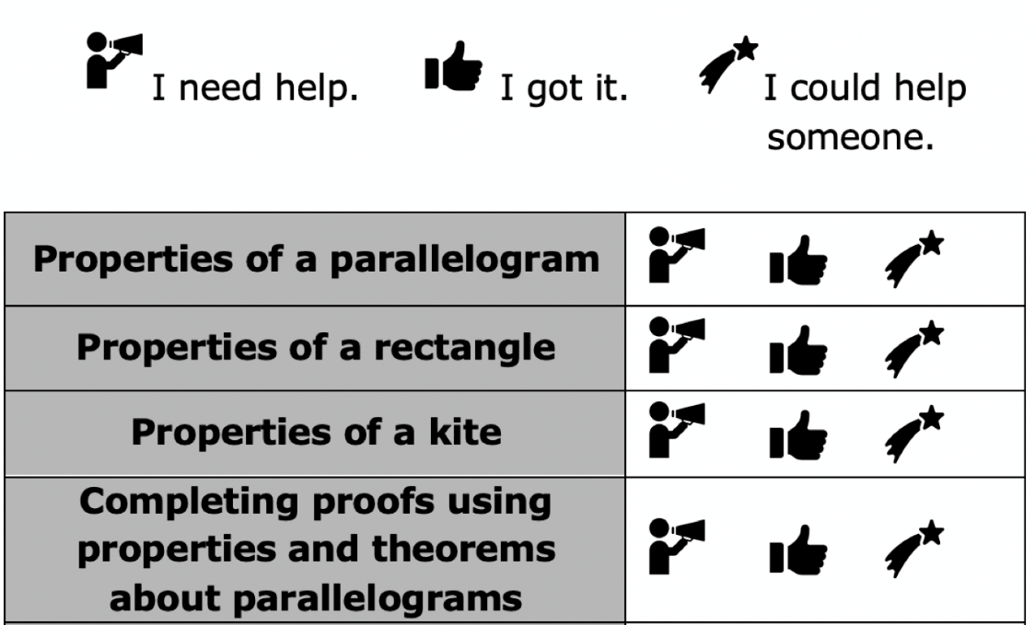
8.6.4 Wrap-Up: Reflection
Circle the icon that best describes your understanding of each concept below.
volume 2, pg. 42

Slide 17
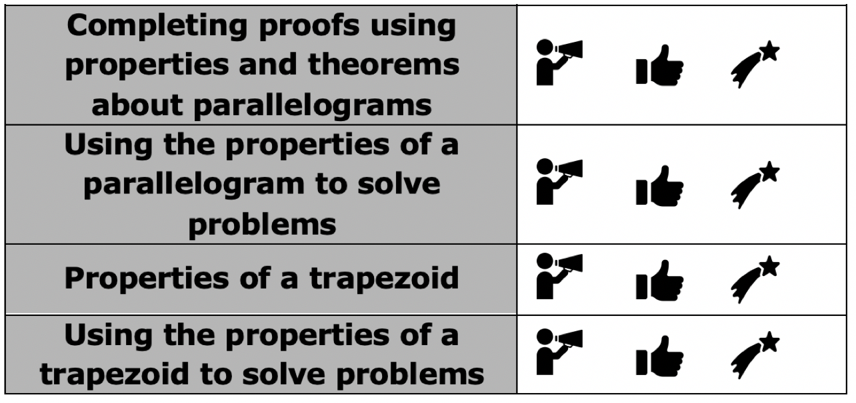
volume 2, pg. 42

